Slide 1

.NET Revamped
Wyn Van Devanter
@wynv
Pat Leong
@thepatleong

Slide 2





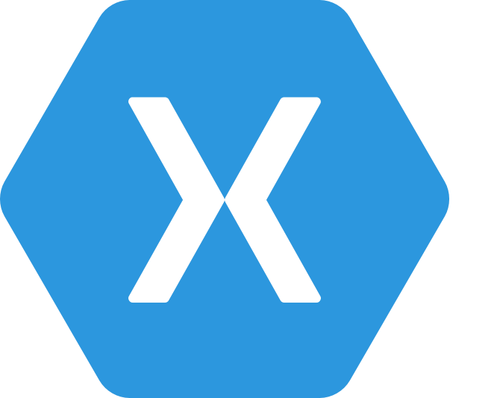
.NET Any developer, any app, any platform
iOS
OS X
Notes:
No better time to be a .NET developer – you have more scenarios at your finger tips than ever, using the technology you love and make you productive. You can literally build any app for any device for any platform with .NET.

Slide 3
Exciting times ahead for .NET
Multi-purpose, comprehensive framework for desktop and web applications
Modern DEVICE EXPERIENCE
Universal Windows platform
Unified development across Windows devices
XAMARIN
Extend your reach to any device with .NET
.NET FRAMEWORK
Modern CLOUD EXPERIENCE
.NET CORE
Cross-platform, high performance .NET
ASP.NET Core
Cloud optimized framework for micro services

Slide 4
.NET today—the family gets bigger
.NET FRAMEWORK
.NET CORE
XAMARIN
Platform for .NET applications on Windows
Cross-platform and open source framework optimized for modern app needs and developer workflows
Cross-platform and open source Mono-based runtime for iOS, OS X, and Android devices
Distributed with Windows
Distributed with app
Distributed with app
Notes:
Notes: Focus on the great additions to the .NET Framework, enabling developers to target the latest applications in the cloud and devices. Explain the distribution mechanism of each. .NET Framework is distributed and available on Windows whereas .NET Core & Xamarin are distributed with the app.

Slide 5
.NET today—app models and libraries
.NET FRAMEWORK
.NET CORE
XAMARIN
APP
MODELS
WPF
Windows Forms
UWP
iOS
Android
ASP.NET
ASP.NET Core
OS X
BASE
LIBRARIES
Base Class Library
Core Library
Mono Class Library
COMMON INFRASTRUCTURE
Compilers
Languages
Runtime components
Notes:
Notes: Even if we are reusing a lot across components (especially with the open sourcing last year), the reality is that each platform has its own implementation of the base libraries.
Note: .NET Framework BCL and Mono BCL are the same APIs, different implementation. .NET Core “Core Library” is a similar set of APIs, but different.

Slide 6
.NET today—reusing code
.NET FRAMEWORK
.NET CORE
XAMARIN
APP
MODELS
My code
BASE
LIBRARIES
PCL reference assemblies
Implementation 3
Reference implementation
Implementation 2
Implementation 1
COMMON INFRASTRUCTURE
Compilers
Languages
Runtime components
Notes:
Notes: To address this, we introduced portable class libraries, which allow abstracting over each platform’s libraries with reference implementations.

Slide 7
.NET today—reusing code
.NET FRAMEWORK
.NET CORE
XAMARIN
APP
MODELS
My code
CHALLENGES
Difficult to reuse skills
Need to master 3+1 base class libraries
Difficult to reuse code
Need to target a small common denominator
Difficult to innovate
Need implementations on each platform
BASE
LIBRARIES
PCL reference assemblies
Implementation 3
Reference implementation
Implementation 2
Implementation 1
COMMON INFRASTRUCTURE
Compilers
Languages
Runtime components

Slide 8
.NET tomorrow
.NET FRAMEWORK
.NET CORE
XAMARIN
WPF
Windows Forms
UWP
iOS
Android
ASP.NET
ASP.NET Core
OS X
.NET STANDARD LIBRARY
One library to rule them all
COMMON INFRASTRUCTURE
Compilers
Languages
Runtime components
Notes:
Notes: Please welcome the .NET Standard Library [explain details]
As we move into the future we want to make it much easier for .NET developers to write their code once and be able to execute across .NET implementations, whether that’s .NET Framework, .NET Core, or Mono/Xamarin. To this end, we will continue to evolve and expand the .NET Standard into a set of APIs that are shared broadly across frameworks and application models. This will provide our ecosystem with much more explosive growth with libraries that can shared much more easily.

Slide 9
.NET tomorrow—reusing code
.NET FRAMEWORK
.NET CORE
XAMARIN
BENEFITS
Reuse skills
Master one library, not a platform
Reuse code
Big surface area - no small common denominator
Faster innovation
.NET Standard can grow without updating platforms
Reference implementations
My code
Full implementations
COMMON INFRASTRUCTURE
Compilers
Languages
Runtime components
Notes:
Notes: Reusing code is dramatically better with the .NET Standard Library. It includes reference implementations, just like the PCL but it also can be extended with full implementations shared across all platforms.

Slide 10


.NET future innovation
APP MODEL INNOVATION
.NET FRAMEWORK
.NET CORE
XAMARIN
TOOLS
WPF
Windows Forms
UWP
iOS
Android
ASP.NET
ASP.NET Core
OS X
*
Visual Studio
.NET INNOVATION
.NET STANDARD LIBRARY
One library to rule them all
Visual Studio Code
COMMON INFRASTRUCTURE
Xamarin Studio
Compilers
Languages
Runtime components
Notes:
The standard library allows us to innovate much more quickly and those innovations are picked up by all the platforms. Tooling innovation affects both app models & standard library

Slide 11
.NET future innovation
APP MODEL INNOVATION
.NET FRAMEWORK
.NET CORE
XAMARIN
TOOLS
WPF
Windows Forms
UWP
iOS
Android
ASP.NET
ASP.NET Core
OS X
*
Visual Studio
.NET INNOVATION
.NET STANDARD LIBRARY
One library to rule them all
Visual Studio Code
COMMON INFRASTRUCTURE
Xamarin Studio
Compilers
Languages
Runtime components
Notes:
The standard library allows us to innovate much more quickly and those innovations are picked up by all the platforms. Tooling innovation affects both app models & standard library

Slide 12
.NET Standard—returning APIs
More API’s will come back post 1.0 (App Domains, Full Reflection, Binary Serialization)
Easily move code between .NET Framework, .NET Core and Xamarin
Notes:
AppDomains, BFinary Serializer,

Slide 13
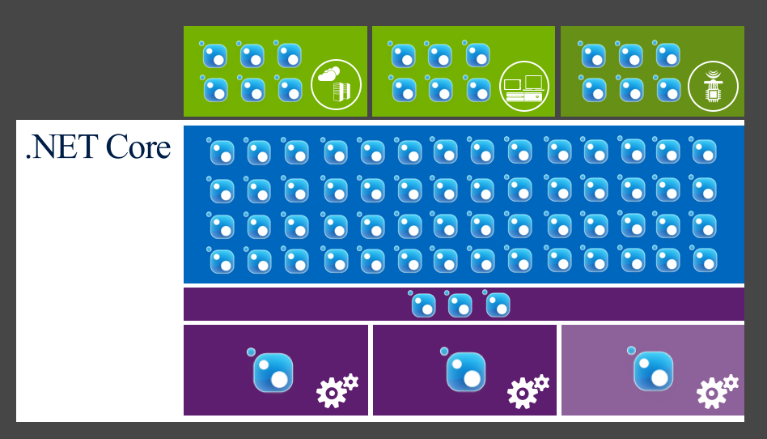
NuGet is mainstream in .NET Core

Slide 14
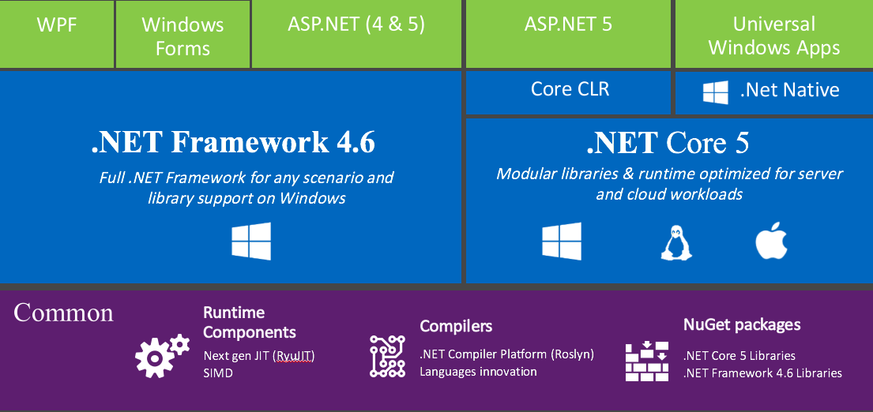
10,000 foot view

Slide 15
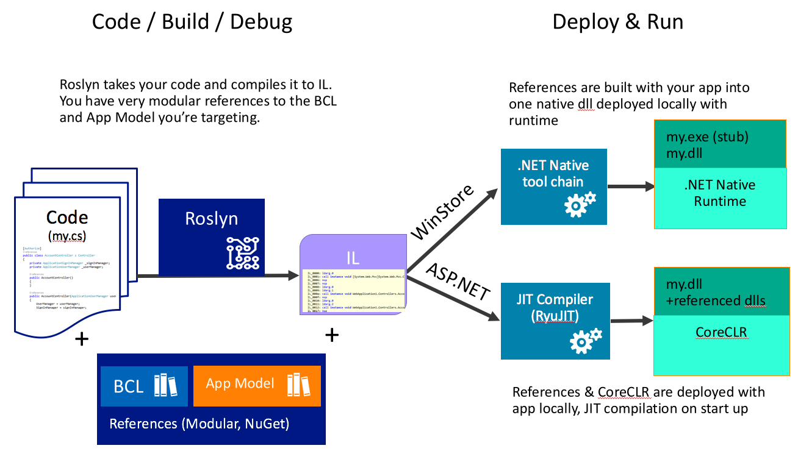

Slide 16
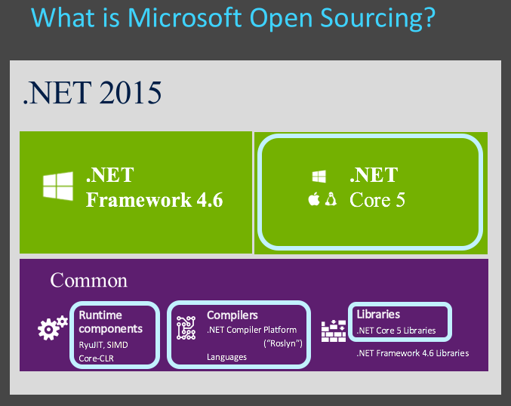

Slide 17
Where does ASP.NET fit in?
ASP.NET 5
Unified framework for MVC, Web API and SignalR
.NET Framework 4.6 stack and libs
.NET Core 5 stack and libs
Full .NET Framework for any scenario and library support
Small runtime optimized for server and cloud workloads

Slide 18
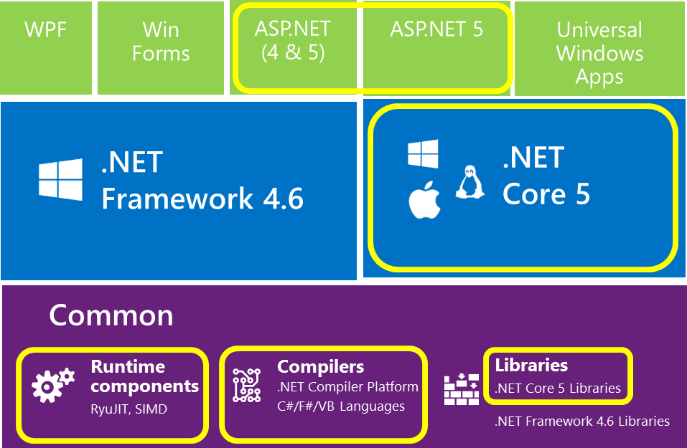
What is Open Source?

Slide 19


ASP.NET 2015 in a Nutshell
Visual Basic 14
Visual Basic 14 (coming soon)
C#
Web
Forms
MVC 5.x
Web API 2.2
MVC / Web API 6
ASP.NET 4.6 System.Web
ASP.NET 5
Core CLR
.Net Native
.NET Framework 4.6
.NET Core 5
Full .NET Framework for any scenario and
library support on Windows
Modular libraries & runtime optimized for server and cloud workloads

Slide 20
Languages
C#
Flexible, powerful, multi-purpose
Investments in C# 7: Evolve for modern patterns in distributed applications: tuples, pattern matching, others.
VB
Simple, easy to use
Investments in VB 15: Bring key language features and platforms while keeping VB simplicity principles.
F#
Elegant functional programming
Investments in vNext: Language updates for C# 7 / VB 15 interop, platform support and tooling updates.
Notes:
C#, Visual Basic and F# are all supported on .NET Core and can be used to create cross-platform apps that run anywhere. In addition, C# is supported in other cross-platform editors like Visual Studio Code via OmniSharp. Currently there are project templates provided C# in Visual Studio and Visual Basic templates will be added as the tooling reaches RTM (with Visual Studio NEXT).

Slide 21
.NET future innovation
APP MODEL INNOVATION
.NET FRAMEWORK
.NET CORE
XAMARIN
TOOLS
WPF
Windows Forms
UWP
iOS
Android
ASP.NET
ASP.NET Core
OS X
*
Visual Studio
.NET INNOVATION
.NET STANDARD LIBRARY
One library to rule them all
Visual Studio Code
COMMON INFRASTRUCTURE
Xamarin Studio
Compilers
Languages
Runtime components
Notes:
The standard library allows us to innovate much more quickly and those innovations are picked up by all the platforms. Tooling innovation affects both app models & standard library

Slide 22

Tools for any developer and any app
Visual Studio
Visual Studio Code
Xamarin Studio
Command Line Interface
OPEN
Any App: Desktop, Mobile, Server, Cloud
Any Developer: IDE, Code editor, CLI
Any OS: Windows, OS X, Linux
POWERFUL
Easy and quick installation
Better productivity with reimagined inner loop
First-class .NET experiences
Notes:
In addition to a cross-platform .NET Core, we’re also providing tooling for any developer platform and workflow. Whether you develop with a PC or a Mac, we’ve got you covered with a wide range of tooling.

Slide 23
.NET future innovation
APP MODEL INNOVATION
.NET FRAMEWORK
.NET CORE
XAMARIN
TOOLS
WPF
Windows Forms
UWP
iOS
Android
ASP.NET
ASP.NET Core
OS X
*
Visual Studio
.NET INNOVATION
.NET STANDARD LIBRARY
One library to rule them all
Visual Studio Code
COMMON INFRASTRUCTURE
Xamarin Studio
Compilers
Languages
Runtime components
Notes:
The standard library allows us to innovate much more quickly and those innovations are picked up by all the platforms. Tooling innovation affects both app models & standard library

Slide 24
.NET future innovation
.NET FRAMEWORK
UNIVERSAL WINDOWS PLATFORM
DESKTOP DEVELOPMENT
COMMON
New .NET native tools
HoloLens / Xbox support
Coming soon: Runtime application analysis
WPF improvements like per-monitor DPI and soft keyboard support
ClickOnce—TLS 1.1/1.2 support
XAML edit-and-continue
Desktop to UWP bridge (“Centennial”)
XAML language service updates
Cryptography enhancements

Slide 25
.NET future innovation
.NET CORE
.NET CORE
ASP.NET CORE
New open source and cross-platform .NET runtime and library stack
High performance, including native compilation
New set of command-line tools—“.NET Core CLI”—for compiling and publishing apps
Supports app local, “shared framework,” and Docker deployment
ASP.NET Core builds on top of .NET Core
Single framework for web pages, services, and microservices
Introduces concept of middleware pipeline, enabling you to inject as little or much functionality as needed
Fully integrates with CLI tooling and uses the shared framework
Takes advantage of .NET Core performance and includes a very high performance web server, built on LibUV

Slide 26
.NET future innovation
XAMARIN
CORE PLATFORM
TOOLS
LIFECYCLE
Xamarin SDK now open source as part of .NET Foundation
Xamarin Forms updates
iOS Simulator
iOS USB Remoting
Xamarin Forms previewer
Test recorder for Visual Studio
Visual Studio Team Services, HockeyApp and Xamarin Test Cloud integration

Slide 27
.NET Open Source
Timeline

Slide 28
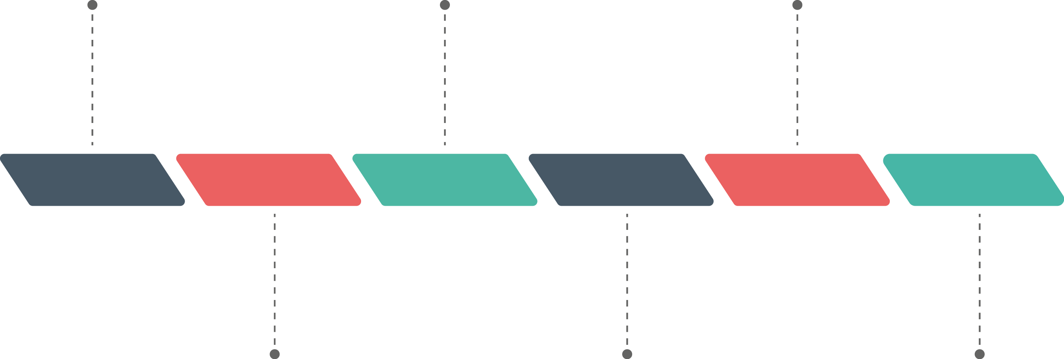
.NET Foundation
.NET Core - Open Sourced
Roslyn
Shared Source “Rotor”
.NET Reference Source
2001
2004
2008
2012
2014
Today
Mono
ASP.NET Open Sourced
TypeScript
.NET Core everywhere
Xamarin OSS
.NET Core RTM June 27th

Slide 29
.NET Open Source
Timeline

Slide 30
.NET Foundation
.NET Core - Open Sourced
Roslyn
Shared Source “Rotor”
.NET Reference Source
2001
2004
2008
2012
2014
Today
Mono
ASP.NET Open Sourced
TypeScript
.NET Core everywhere
Xamarin OSS
.NET Core RTM June 27th

Slide 31
Flexibility Of .NET Core
Creating More Opportunities
Notes:
OSS, Crossplatform

Slide 32


ASP.NET Core 1.0 and the modern web
Totally modular
Faster development cycle
Seamless transition from on-premises to cloud
Choose your editors and tool
Open source with contributions
OSS
Cross-platform
Fast

Slide 33
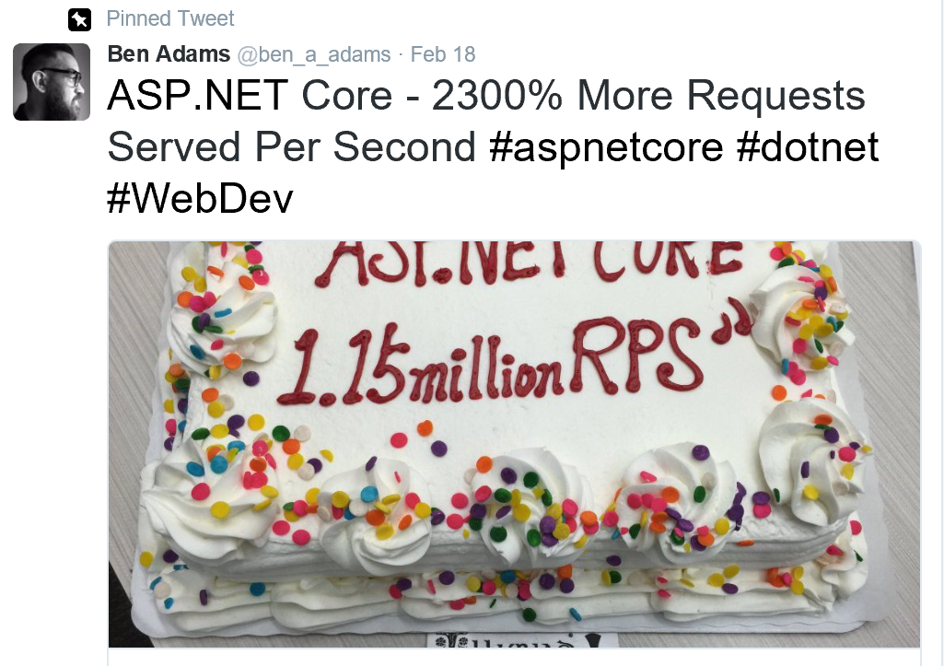
ASP.NET Core 1.15 Million RPS
Ben Adams
web.ageofascent.com
Notes:
We can’t talk about ASP.NET community without calling out Ben Adams. He got inspired watching our weekly ASP.NET Community Standups and started contributing to the ASP.NET server codebase, leading to some huge performance gains!

Slide 34

OSS
More Contributors
More Users
More Choices
Notes:
Open Source = More contributors and community innovation
Cross-platform = More users
More tools = Flexible development workflows

Slide 35




It’s all on GitHub
ASP.NET
Github.com/aspnet
Github.com/dotnet
Github.com/fsharp
Open.xamarin.com

Slide 36
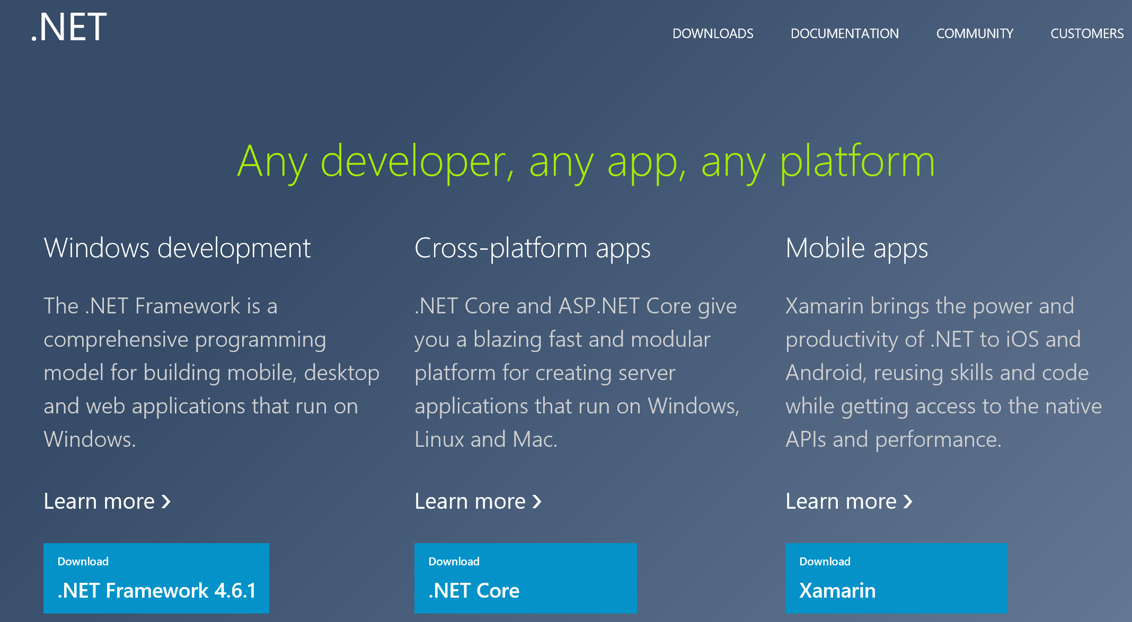
Notes:
Show http://dot.net. Show that from the homepage on getting started with .NET you are immediately welcomed regardless of the type of developer you are.

Slide 37
Get Involved

Slide 38



.NET Compiler Platform ("Roslyn")
MVVM Light Toolkit
MSBuild
ASP.NET MVC
IdentityManager
ASP.NET Core
MEF
.NET Core
.NET SDK for Hadoop
.NET Micro Framework
Kudu
Cecil
Mimekit
Mono
Mailkit
Xamarin.Auth
Umbraco
Cake
Open Live Writer
NuGet
WorldWide Telescope
Couchbase Lite for .NET
ASP.NET Web Pages
Microsoft Azure SDK for .NET
ASP.NET SignalR
WCF
Openness
Community
Rapid innovation
LLILC
Xamarin SDK
Entity Framework
Open XML SDK
IdentityServer
Microsoft Azure WebJobs SDK
Microsoft Web Protection Library
OWIN Authentication Middleware
Orchard CMS
ProtoBuild
ASP.NET Web API
System.Drawing
Orleans
ASP.NET AJAX Control Toolkit
Prism
Xamarin.Mobile
Salesforce Toolkits for .NET
Protection
Practices
Visibility
Support
Licenses
Copyrights
Trademarks
Patents
Mentorship
Governance
Feedback
Co-ordination
Media
Branding
Events
Hosting
Code signing
CLA Management
Swag
Notes:
Description (“what is the .NET Foundation”)
The .NET Foundation is an independent organization created to foster open development and collaboration around the growing collection of open source technologies for.NET. It will serve as a forum for commercial and community developers alike with a set of practices and processes that strengthen the future of the .NET ecosystem.
Story telling (“why the .NET Foundation”)
In 2012 we announced how some key components of .NET such as ASP.NET MVC or Entity Framework embraced a new development process that was more transparent, open, and community driven. Since then, Microsoft has received great feedback from you. Increasing our investments in .NET, while opening the process to the community has allowed .NET to innovate faster with feedback and contributions. With the .NET Foundation we want to extend this new development model to be the norm for .NET and not the exception. We want to make sure that .NET projects (both from Microsoft and from other companies and individual contributors) have a place that provides the mechanisms to promote the openness, community participation and rapid innovation to build the next generation of the .NET ecosystem.
Messaging pillars (“what are the top three things I need to know about the .NET Foundation”)
It opens the development process for .NET: The .NET Foundation brings into one common umbrella existing and new relevant open source projects for the .NET platform, such as ASP.NET, Entity Framework and the recently added .NET Compiler Platform (“Roslyn”). The .NET Foundation will provide the frame for making this the norm moving forward, so more and more components and libraries of .NET are using an open process that is transparent and welcomes your participation.
It encourages customers, partners and the broader community to participate: The .NET Foundation will foster the involvement and direct code contributions from the community, both through its board members, advisory council, technical steering group, as well as directly from individual developers, through an open and transparent governance model that strengthens the future of .NET.
It promotes innovation by a vibrant partner ecosystem and open source community: The .NET Foundation will promote commercial partners and open source developers to build solutions that leverage the platform openness to provide additional innovation to .NET developers. This includes extending .NET to other platforms, extending Visual Studio to create new experiences, providing additional tools or extending the framework and libraries with new capabilities.
Call to action: Join the conversation
We are just taking the first steps in the creation of the .NET Foundation because we want your feedback and participation from the very beginning. We are starting with a core set of participants including representatives for the .NET open source community, partners and enterprises such as Miguel de Icaza and Salesforce for example, who will collaborate to define the frame of the .NET Foundation. You can actually be part of that process too by providing feedback at dotnetfoundation.org.

Slide 39
Developed in the open together
Fully open development process
Open Source
Open to community contributions
Open process: roadmap, design docs, standups…
+ Great community momentum
>175 repositories
>24,000 forks
>4,000 contributors
www.dotnetfoundation.org
= Amazing results
1.15+ Million requests/second!
New performance record for .NET Core
8x node.js performance in our labs
~40% performance gains contributed by community
Notes:
Up to date benchmarks here:
https://github.com/aspnet/benchmarks

Slide 40
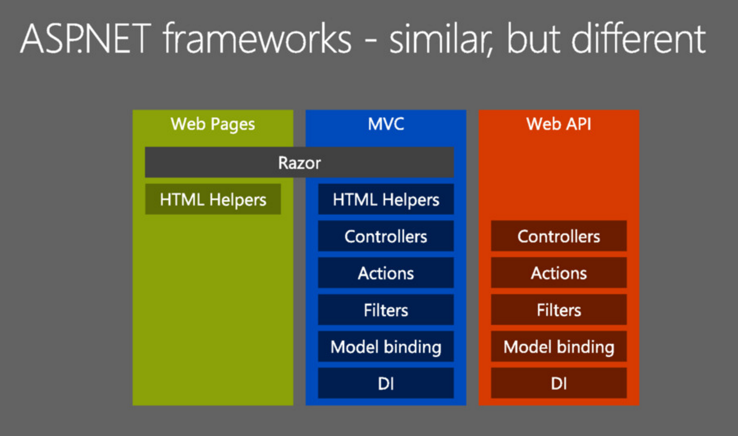
ASP.NET Core Architecture

Slide 41
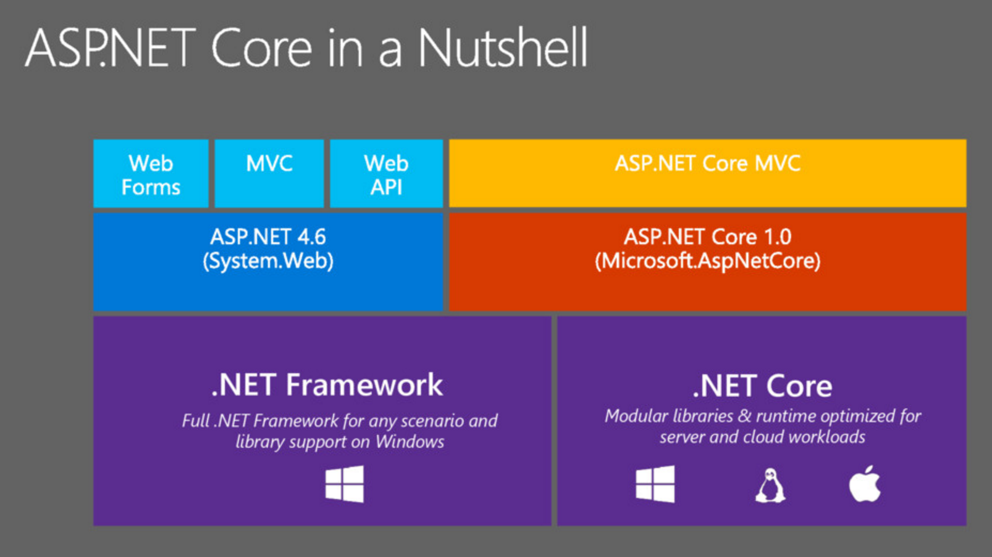
ASP.NET Core Architecture

Slide 42
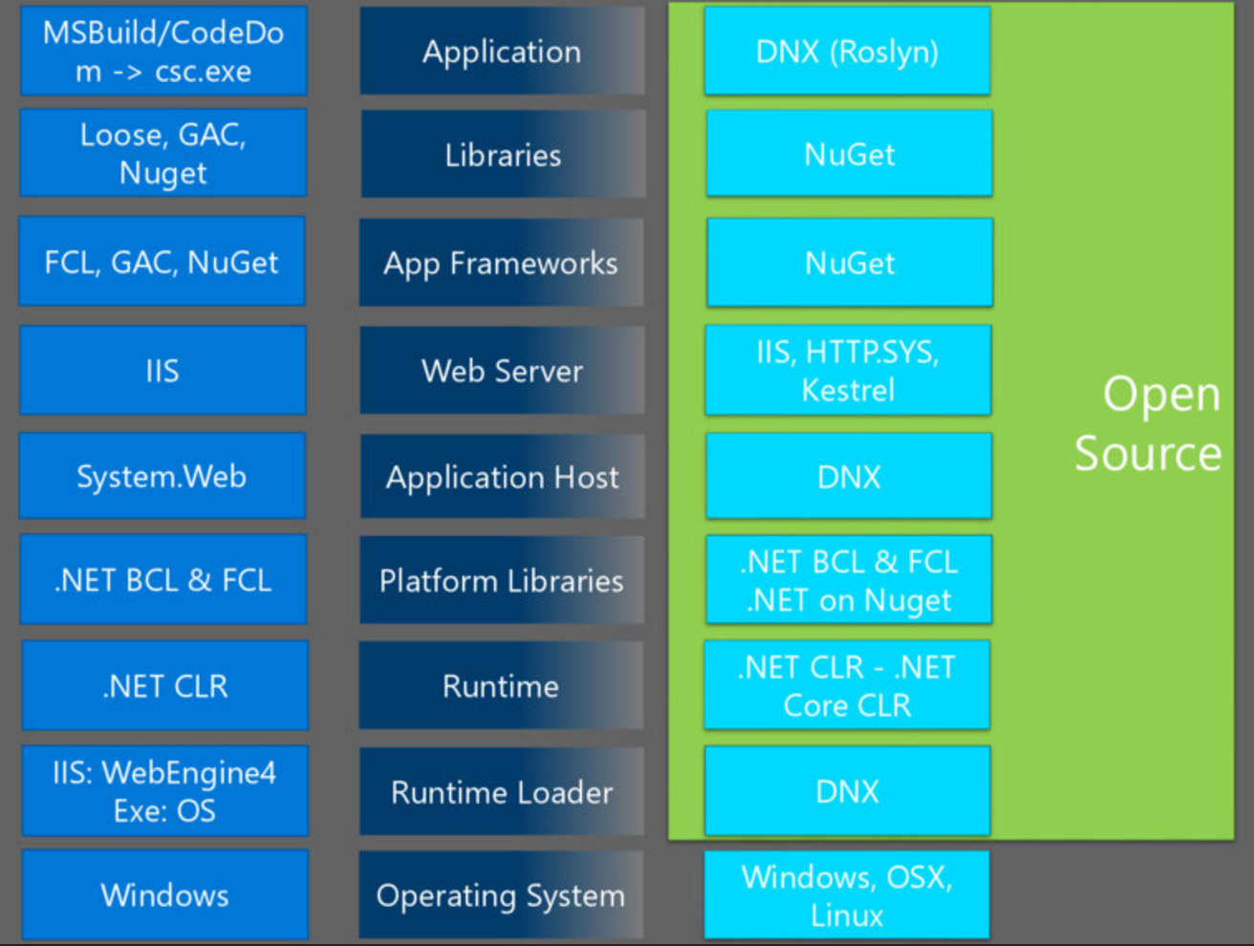
ASP.NET Core Architecure
Notes:
Explain during workshop – app creation

Slide 43
Workshop
https://github.com/Wyntuition/aspnetcore-workshop-kit

Slide 44
Next Steps
Read more
Work on a project
Events
Keep an eye on…

Slide 45
Summary
wyn.vandevanter@excella.com
@wynv
Repos

